Slide 1
Modular arithmetic

Slide 2

When we divide two integers we will have an equation that looks like the following:
$$\frac{A}{B}$$
= Q remainder R
A is the dividend B is the divisor Q is the quotient R is the remainder

Slide 3
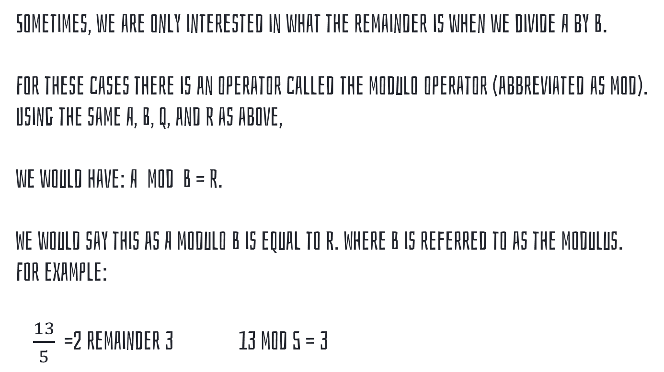
Sometimes, we are only interested in what the remainder is when we divide A by B.
For these cases there is an operator called the modulo operator (abbreviated as mod).
Using the same A, B, Q, and R as above,
we would have: A mod B = R.
We would say this as A modulo B is equal to R. Where B is referred to as the modulus.
For example:
$\frac{13}{5}$ =2 remainder 3 13 mod 5 = 3

Slide 4
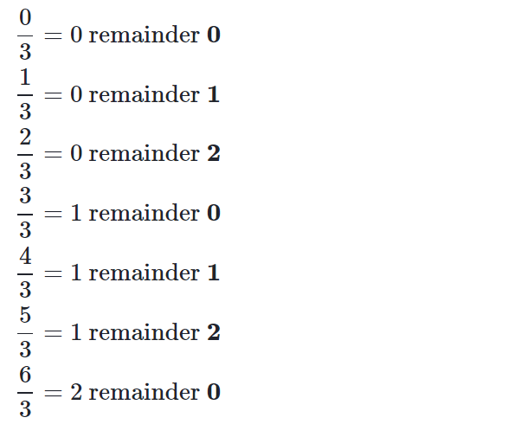
visualize modulus with clocks
Observe what happens when we increment numbers by one and then divide them by 3.
The remainders start at 0 and increases by 1 each time, until the number reaches one less than the number we are dividing by. After that, the sequence repeats.

Slide 5
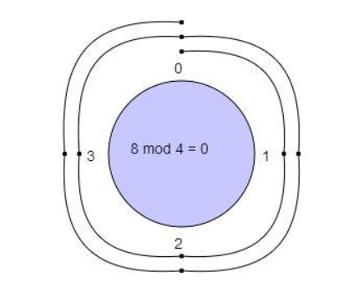
By noticing this, we can visualize the modulo operator by using circles.
We write 0 at the top of a circle and continuing clockwise writing integers 1, 2, ... up to one less than the modulus.
For example, a clock with the 12 replaced by a 0 would be the circle for a modulus of 12.
8 mod 4=?
With a modulus of 4 we make a clock with numbers 0, 1, 2, 3. We start at 0 and go through 8 numbers in a clockwise sequence 1, 2, 3, 0, 1, 2, 3, 0.
We end up at 0 so the 8 mod 4 is 0

Slide 6
Congruence
The way we express this mathematically for mod C is: A ≡ b (mod C).
The above expression is pronounced A is congruent to B modulo C.
≡ is the symbol for congruence, which means the values A and B are in the same equivalence class.
(mod C) tells us what operation we applied to A and B.
when we have both of these, we call “≡” congruence modulo C.
e.g. 26 ≡ 11 (mod 5)
26 mod 5 = 1 so it is in the equivalence class for 1, 11 mod 5 = 1 so it is in the equivalence class for 1, as well.

Slide 7
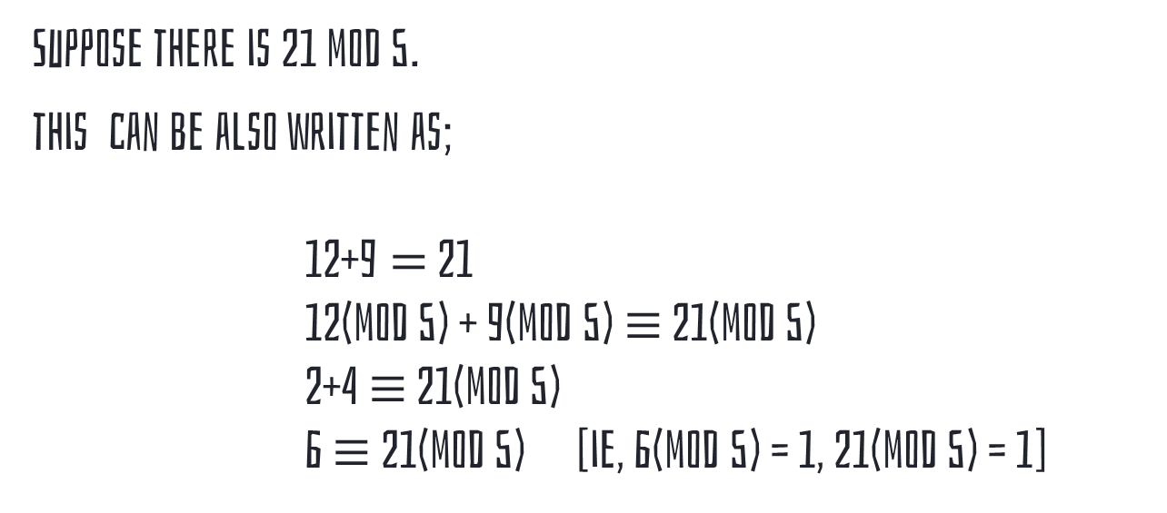
Modular ADDITION
Suppose there is 21 mod 5.
this can be also written as;
12+9$=$ 21
12(mod 5) + 9(mod 5) $≡$ 21(mod 5)
2+4 $≡$ 21(mod 5)
6 $≡$ 21(mod 5) [ie, 6(mod 5) = 1, 21(mod 5) = 1]

Slide 8
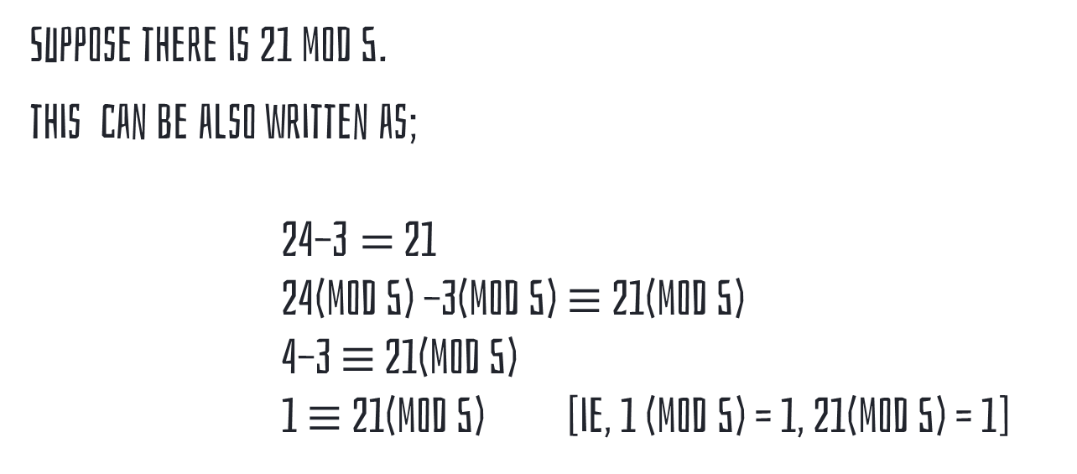
Modular Subtraction
Suppose there is 21 mod 5.
this can be also written as;
24-3$=$ 21
24(mod 5) -3(mod 5) $≡$ 21(mod 5)
4-3 $≡$ 21(mod 5)
1 $≡$ 21(mod 5) [ie, 1 (mod 5) = 1, 21(mod 5) = 1]

Slide 9
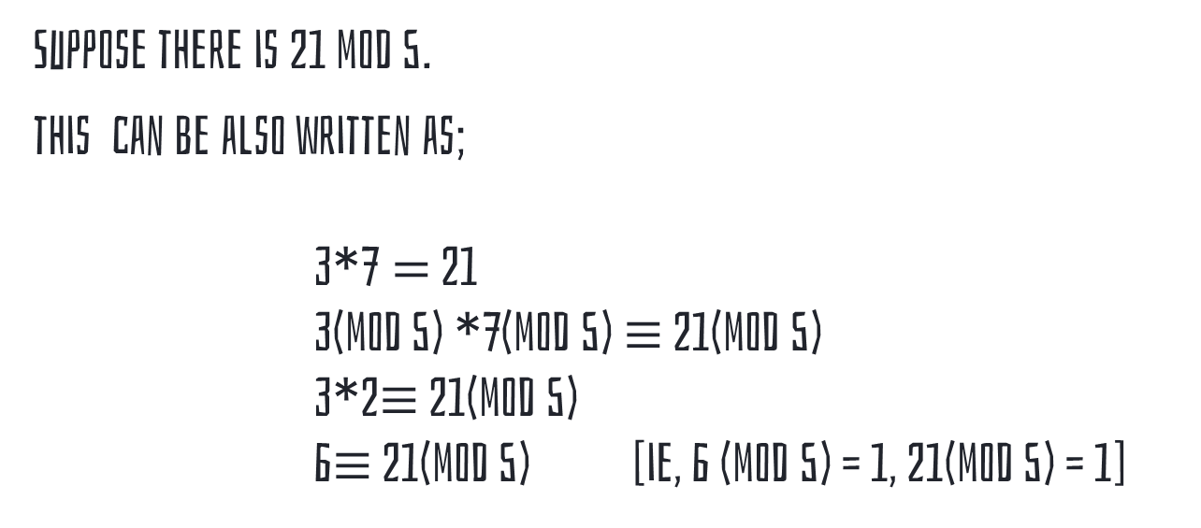
Modular multiplication
Suppose there is 21 mod 5.
this can be also written as;
3*7$=$ 21
3(mod 5) *7(mod 5) $≡$ 21(mod 5)
3*2$≡$ 21(mod 5)
6$≡$ 21(mod 5) [ie, 6 (mod 5) = 1, 21(mod 5) = 1]

